Slide 1
Do Events hosted by Phone Companies rise their stock values?
Ruchiraprakan Pamonpon(21229058)
Jason Sebastian (21224520)

Slide 2
AlphaVantage API
https://www.alphavantage.co/
AlphaVantage is a well-known API providing historical and real-time market data on stocks, foreign exchange (FX), cryptocurrencies, and other financial assets. Developers, analysts, and traders use it extensively to do algorithmic trading, automate trading systems, conduct market research, and incorporate financial data into their applications.

Slide 3
Introduction
As phones got gradually more popular since the release of Iphone. People started getting used to smartphone as another part of their activity. Recent technology is proceeding in a much faster time than the 90s and there is a hype over a new phone release yearly from various phones company. We want to know how new features, consumer expectations, and market trends influence investor behavior and stock performance.

Slide 4
Hypothesis 1: Every time Apple does a phone launch, their stock value rises
Null Hypothesis: Apple launch events do not affect their stock value.

Slide 5
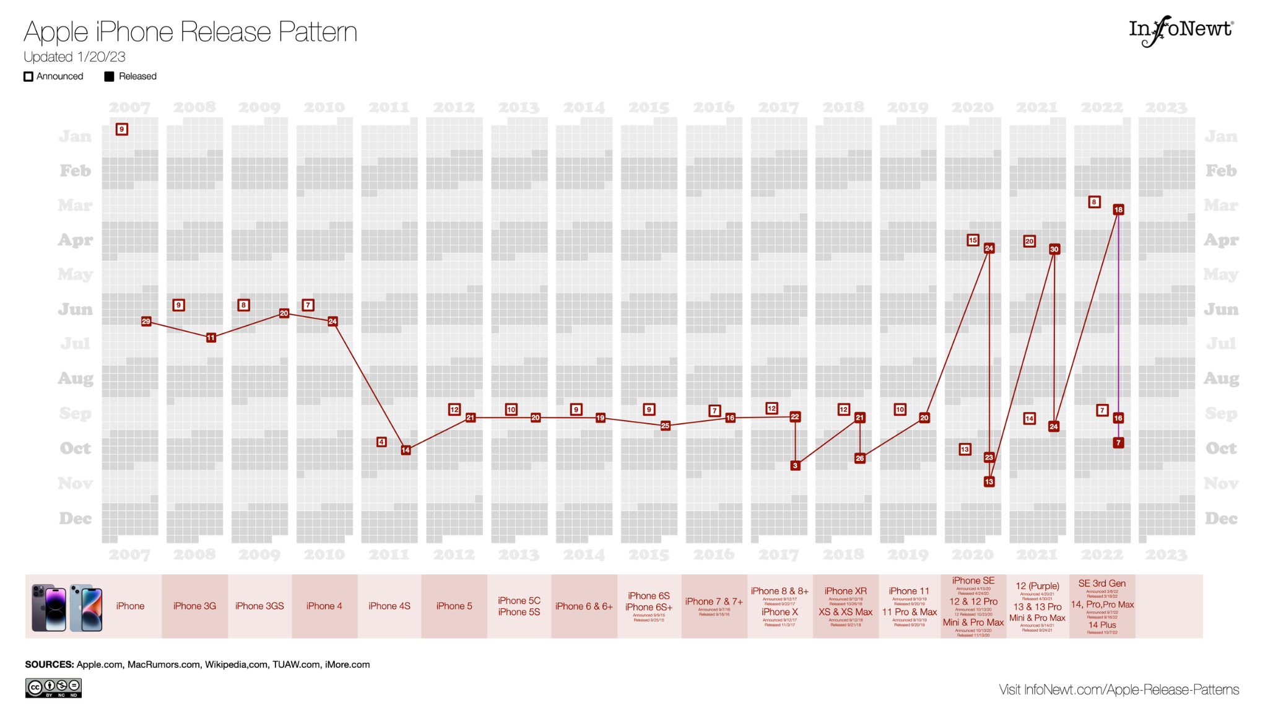
Apple’s Launch Dates
https://infonewt.com/apple-release-patterns

Slide 6
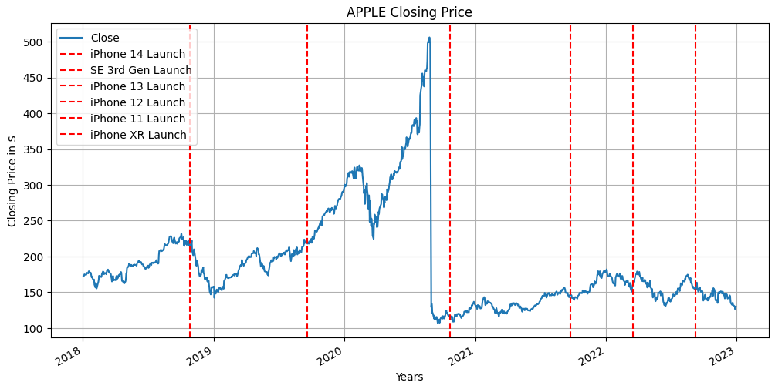
Visual 1:

Slide 7
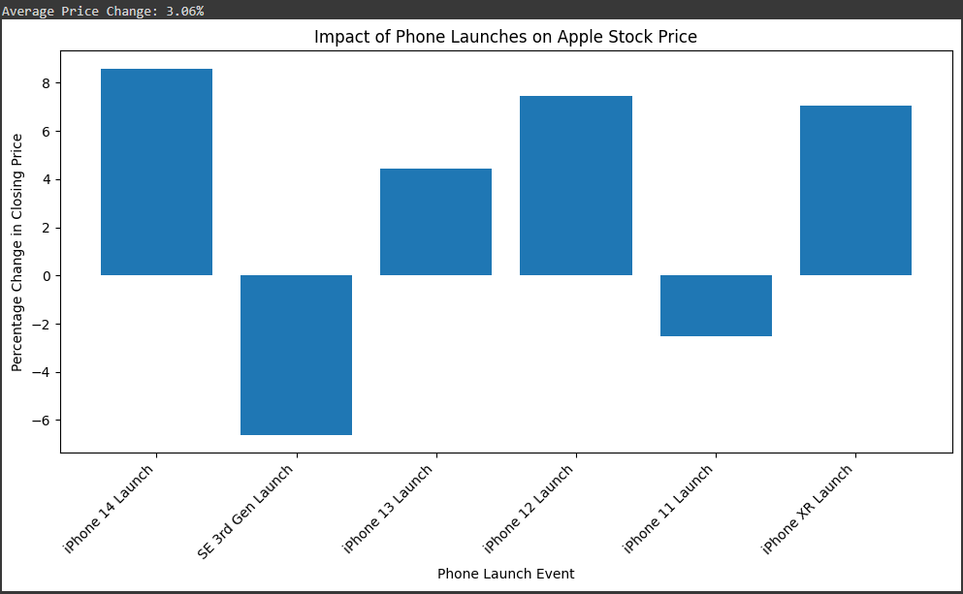
Visual 2:

Slide 8
Explanation
Apple Launch Events do not increase its stock value.
They tend to show a slight increase, but none too significant to prove it is because of the event.
Research has been made that User Generated Content (UGC) has affected the expectations of the launches and can affect the stock prices (van Dieijen et al., 2020).

Slide 9
Hypothesis 2: Samsung’s launch events also show an increase in stock value
Null Hypothesis: Samsung’s launch event do not increase their stock value
https://colab.research.google.com/drive/1gHL4sI7HpGu30-xiqAgSdsdDHN4j3yBG?usp=sharing

Slide 10
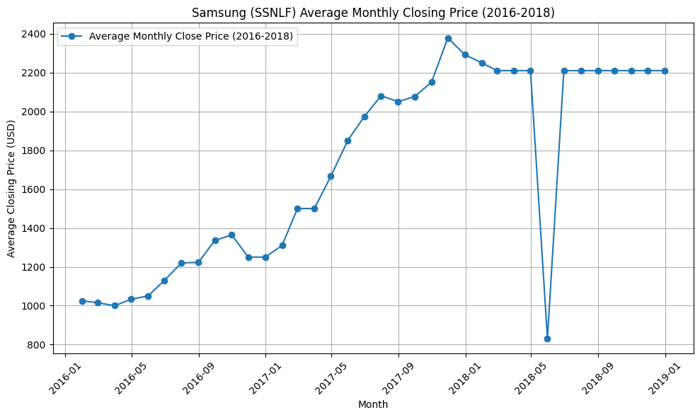
Problem on using AlphaVantage API (Late 2018 stock price)

Slide 11
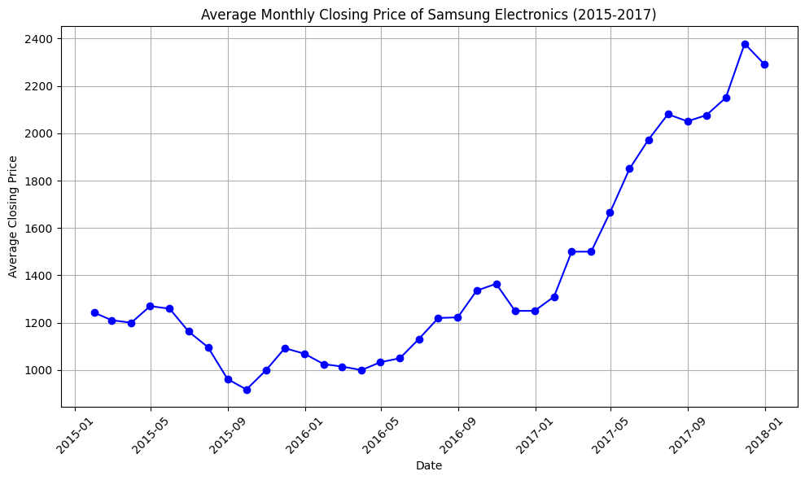
Visual 1: Average stock closing price of samsung by month

Slide 12
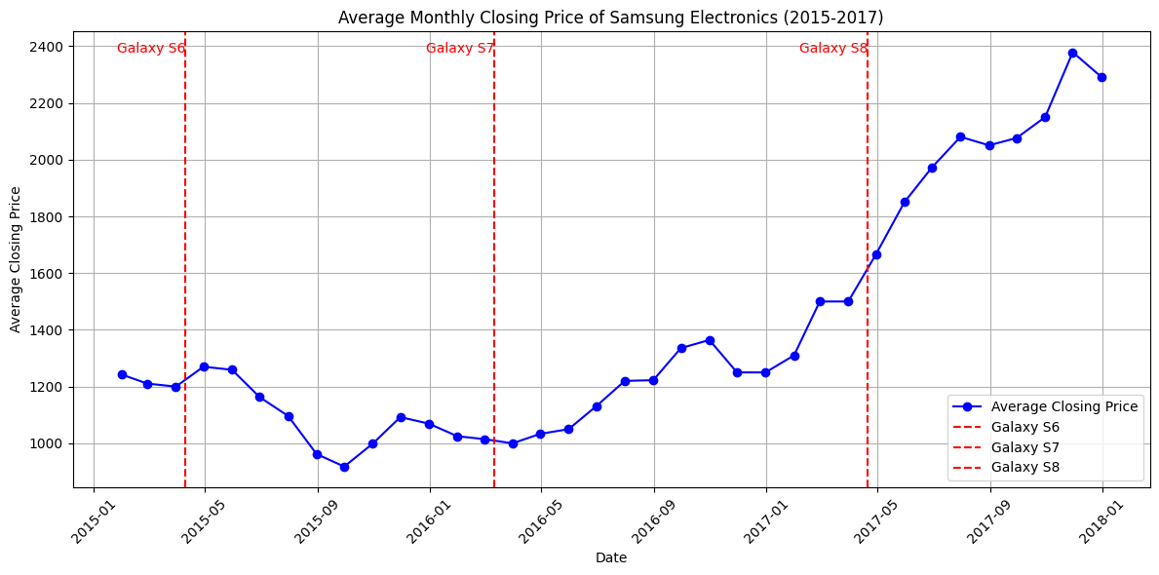
Visual 2: Average stock closing price of samsung by month including Samsung Galaxy S release date within the time frame

Slide 13
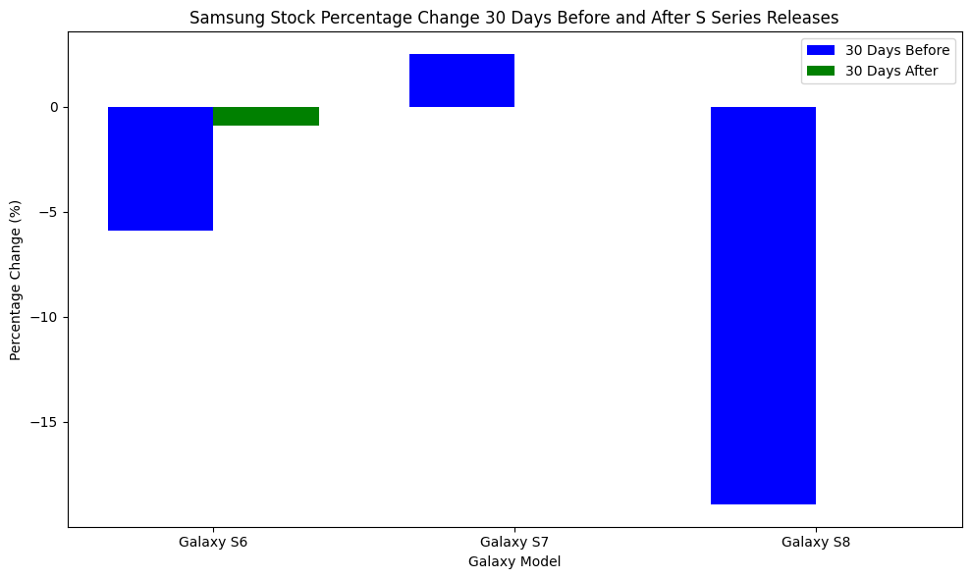
Samsung stock price trend before and after Phone release

Slide 14
Results
Paired t-test results: t-statistic = 1.1354, p-value = 0.1870
Fail to reject the null hypothesis. No significant increase in stock prices after the phone release.

Slide 15
Explanation
Why use the closing graph instead of Opening graph?
When the Galaxy S8 was introduced in March, Samsung noticed a minor gain in stock prices as investors put their trust in the likelihood that buyers will upgrade their existing Samsung phone.
With the release of the Galaxy Note 8, Samsung's second announcement of the year, profits and losses were distributed across cellular carriers and merchants, indicating that Wall Street was uninterested in the bigger, more potent Samsung smartphone.
Apple was one of the few exceptions, with its shares rising by 0.5 percent on the debut of the Galaxy Note 8 (Gonzalez, 2017).

Slide 16
Conclusion
The phone company’s launch events do not result in an increase in stock value.
External factors can be the reason why it fluctuates during the launch events.
Competition does not

Slide 17
Reference
Gonzalez, O. (2017, October 27). The iphone effect: How every new smartphone affects the stock market. NBCNews.com. https://www.nbcnews.com/tech/tech-news/iphone-effect-how-every-new-smartphone-affects-stock-market-n815021
van Dieijen, M., Borah, A., Tellis, G. J., & Franses, P. H. (2020). Big Data Analysis of volatility spillovers of brands across social media and stock markets. Industrial Marketing Management, 88, 465–484. https://doi.org/10.1016/j.indmarman.2018.12.006

